Slide 1
CS414 Rollerball - Project 3
Team Name : String Cheese
Members : Chris Schaffer, Meetkumar Savaliya,
Tim Stroup, Wei Chen , Ya-Hsin Cheng

Slide 2
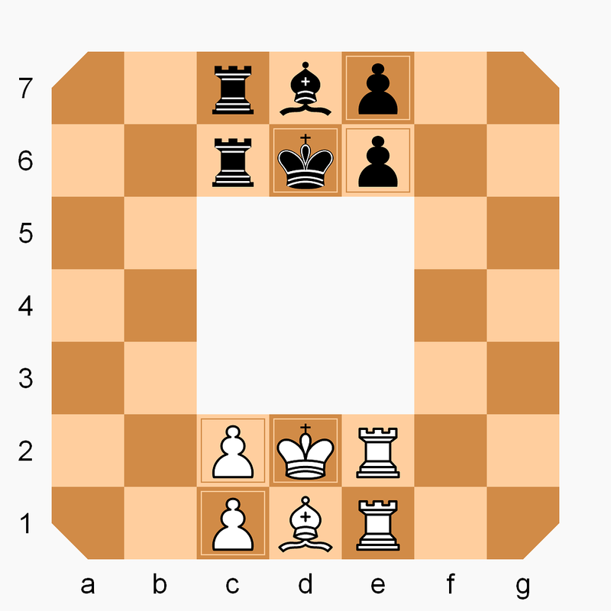
Rollerball rules
The Board
7×7 squares with the central 3×3 blanks
The Pieces
Only can move clockwise
1 King
1 Bishop
2 Rooks
2 Pawns
How to win
Checkmate the enemy king
Travel own king clockwise direction to the start position of the enemy king

Slide 3
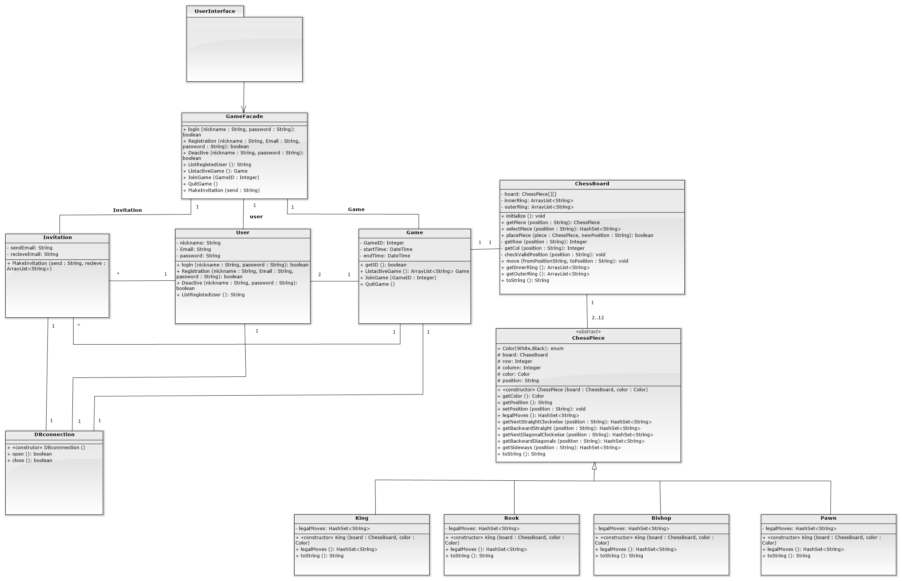
Class Diagram

Slide 6
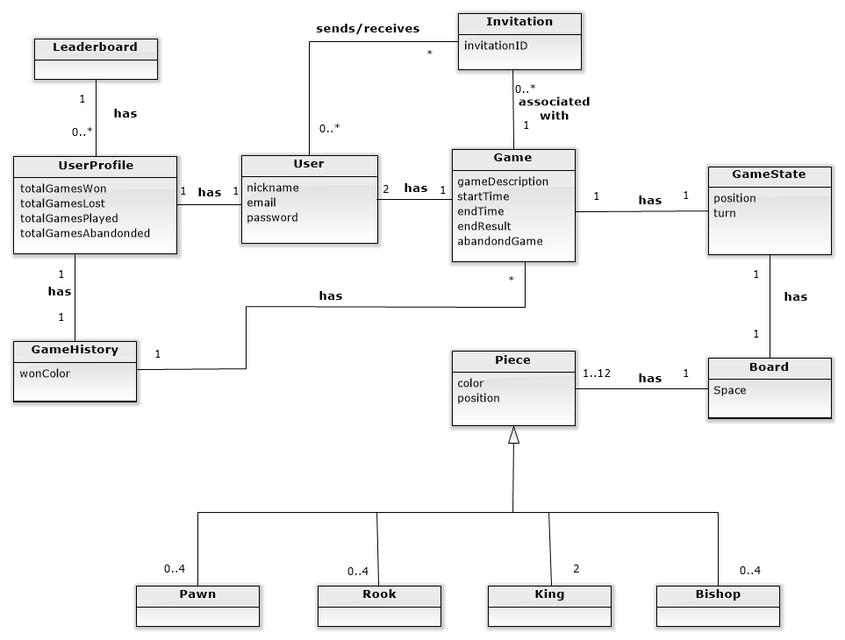
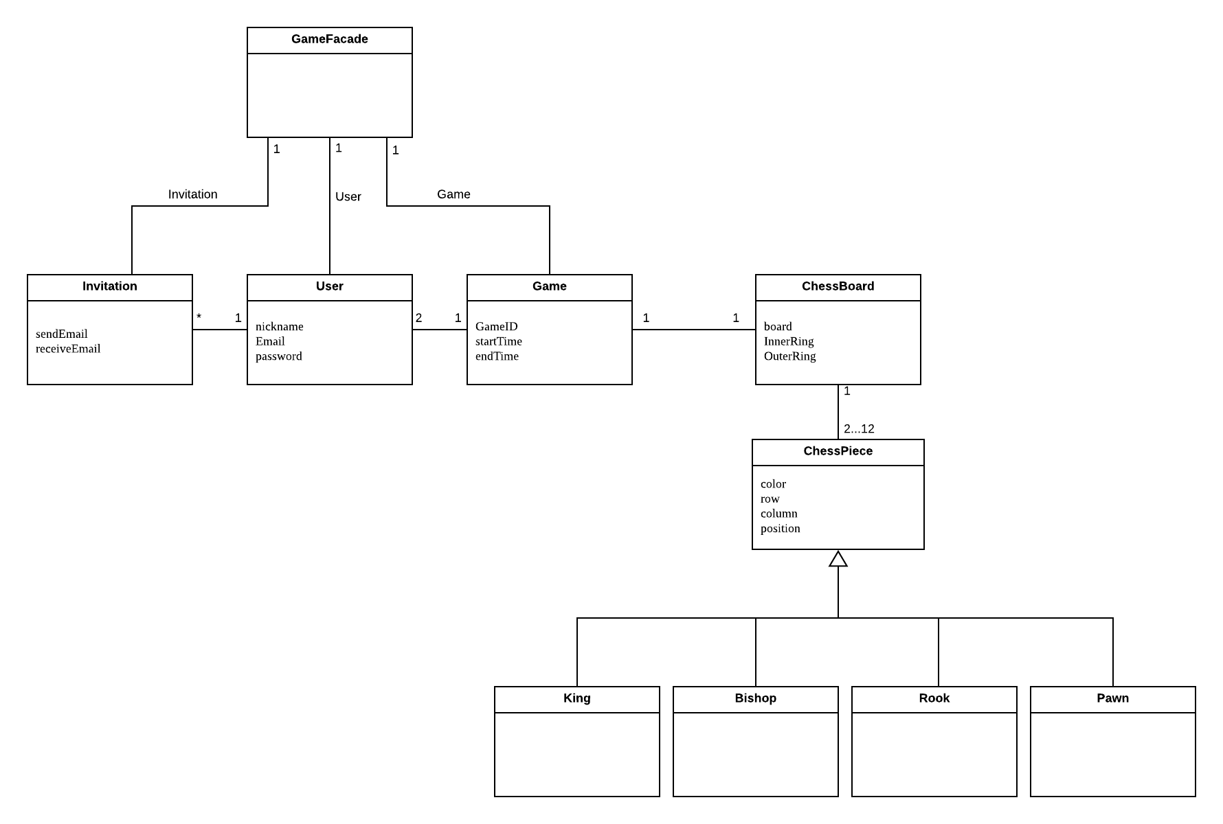
Domain Model Update
Previous one
Updated one

Slide 7
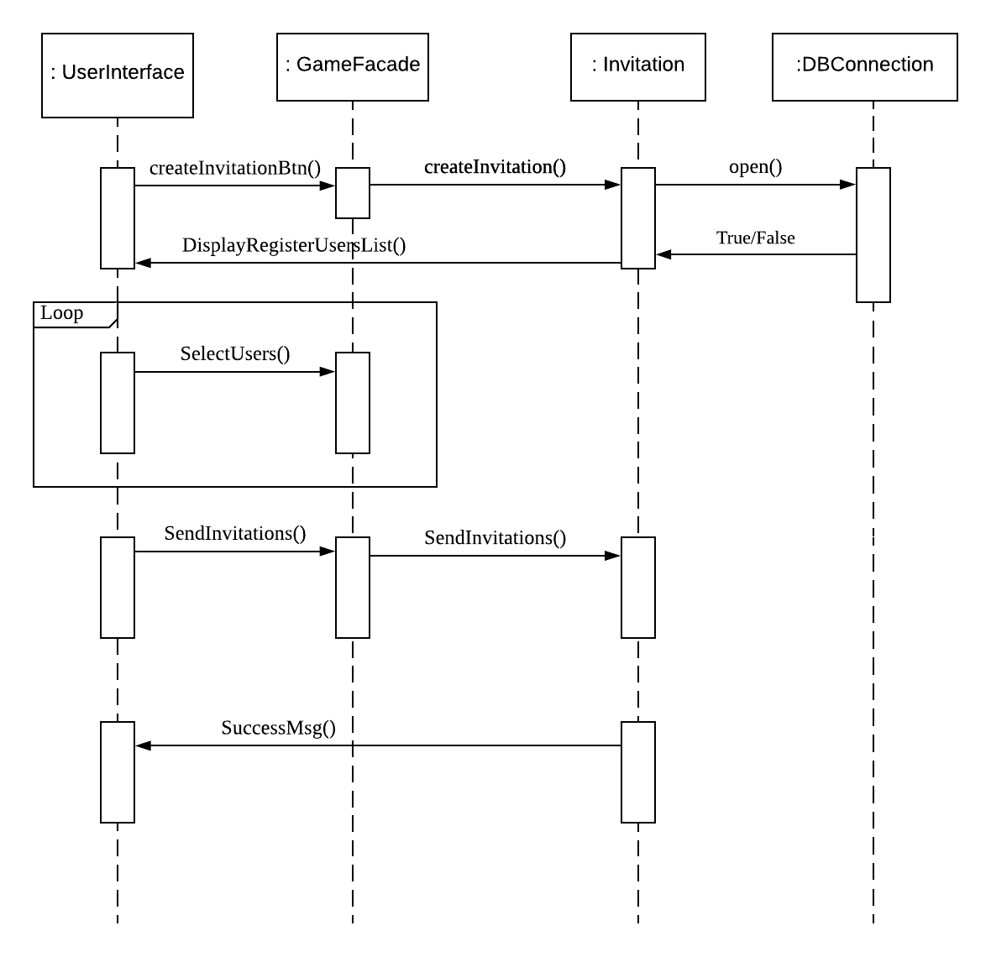
Sequence Diagram – Send Invitation

Slide 8
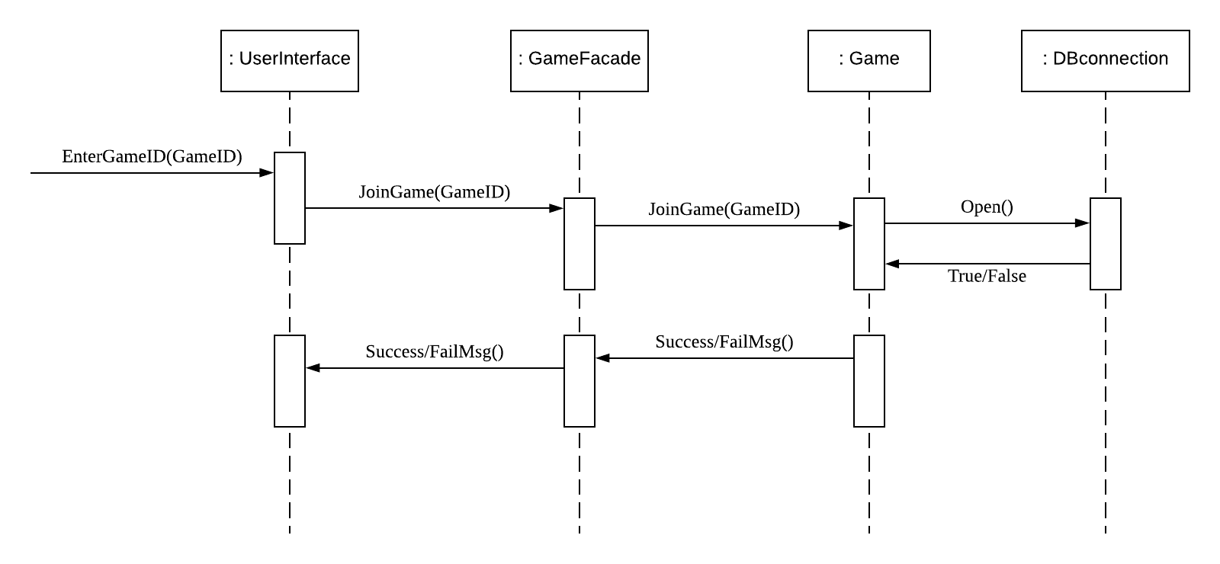
Sequence Diagram – Join Game

Slide 9
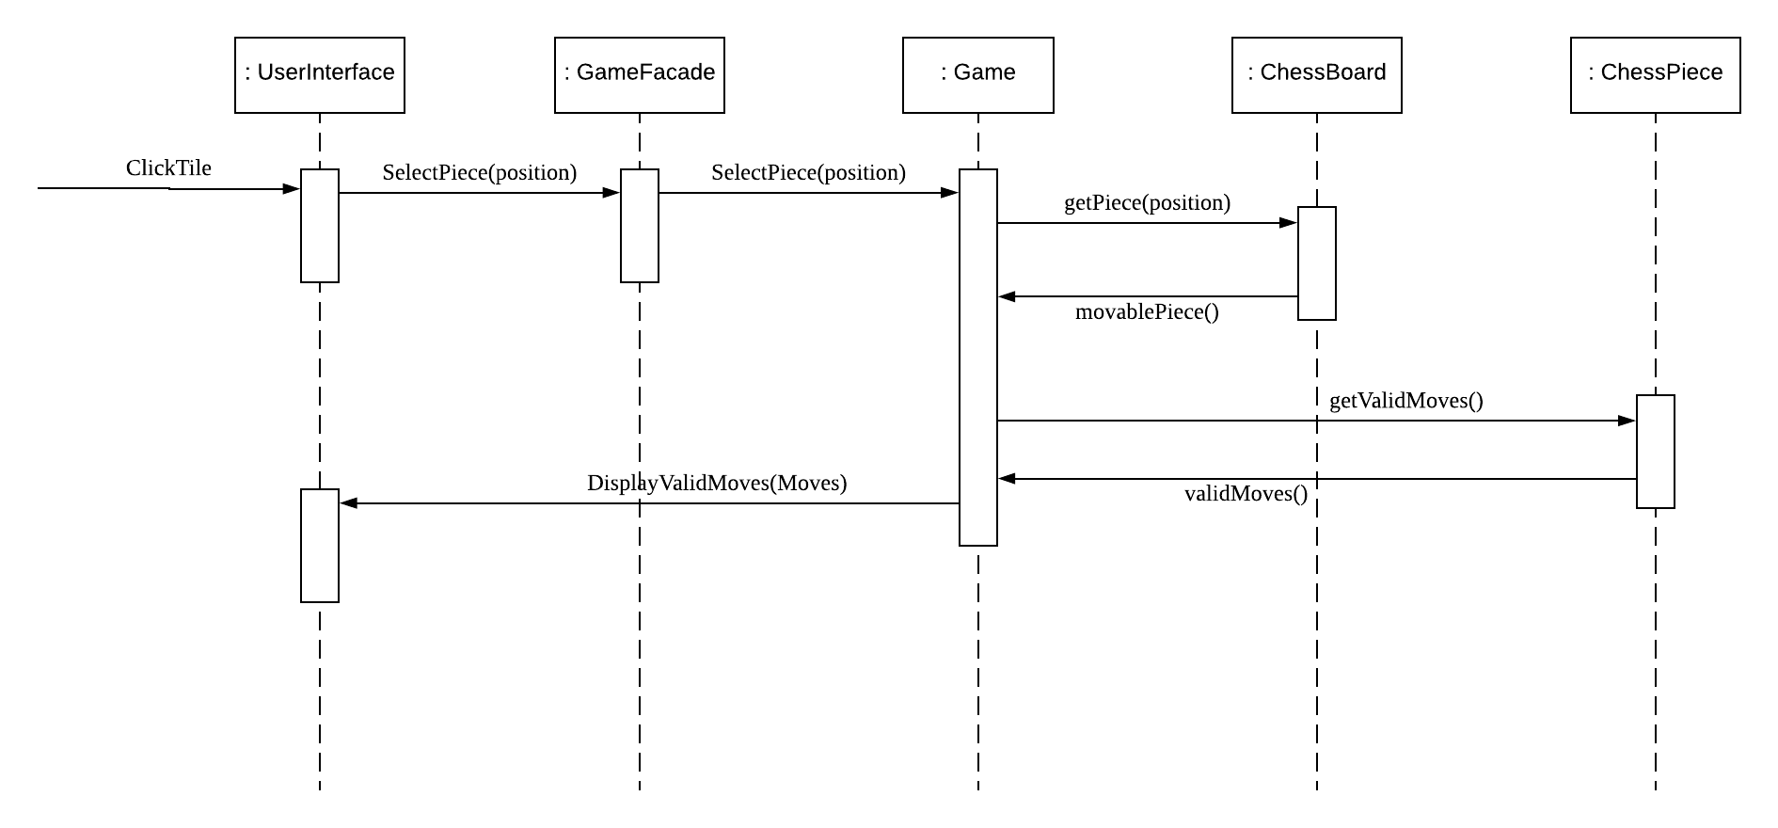
Sequence Diagram – Take Turn

Slide 10
Traceability link matrix
 | ChessBoard | ChessPiece | Game | Invitation | User | DBconnection
UC1-Register Account |  |  |  |  | X | X
UC2-Create Game |  |  | X |  |  | X
UC3-Create Invitation |  |  |  | X |  | X
UC4-Deactivate account |  |  |  |  | X | X
UC5-Join Game |  |  | X |  |  | X
UC6-View Profile |  |  |  |  | X | X
UC7-Log on |  |  |  |  | X | X
UC8-Quit game |  |  | X |  |  | X
UC9-List active games |  |  | X |  |  | X
UC10-Take Turn | X | X | X |  | X | X
UC11-Update Game State | X |  | X |  |  | X
UC12-Display Valid Moves | X | X | X |  | X

Slide 11
Technologies and Tools
Programming Language:
Java
Programming Environment:
IntelliJ IDEA
Testing:
Travis Continuous Integration
Other:
GitHub
Developing Manual

Slide 12
Q & A

